Slide 1

From lab to patient
How statistics shapes decisions in medicine
Nicola Rennie
Royal Statistical Society William Guy Lecturer 2024 - 2025
Notes:
Hi everyone, I’m Nicola Rennie, a lecturer in health data science at Lancaster University. Welcome to the 2024-2025 William Guy Lecture aimed at secondary school students. I’m going to be talking about how we use statistics to help make decisions in medicine and healthcare.

Slide 2


About Me
Lecturer in Health Data Science at Lancaster University
Notes:
But before we get into that, I want to take a moment to tell you a little bit about myself and how I ended up here talking to you. When I was at school, I didn’t really know what sort of job I wanted to do. I quite liked maths and science subjects. I decided to go to university and I studied maths. I picked maths because it seemed like it left quite a lot of different career options open - lots of jobs use numbers. And it was at university, that I first learned about statistics. Statistics is a part of maths that involves collecting, analysing, and interpreting data. It’s about taking lots of information, like numbers or facts, and using it to understand what’s happening and make decisions.
So to me, this idea of statistics seemed quite useful, and quite interesting and so I decided to learn a bit more about it and continued studying statistics. One of the things I really like about statistics, is that you can work in lots of different areas, depending on what you’re interested in.

Slide 3

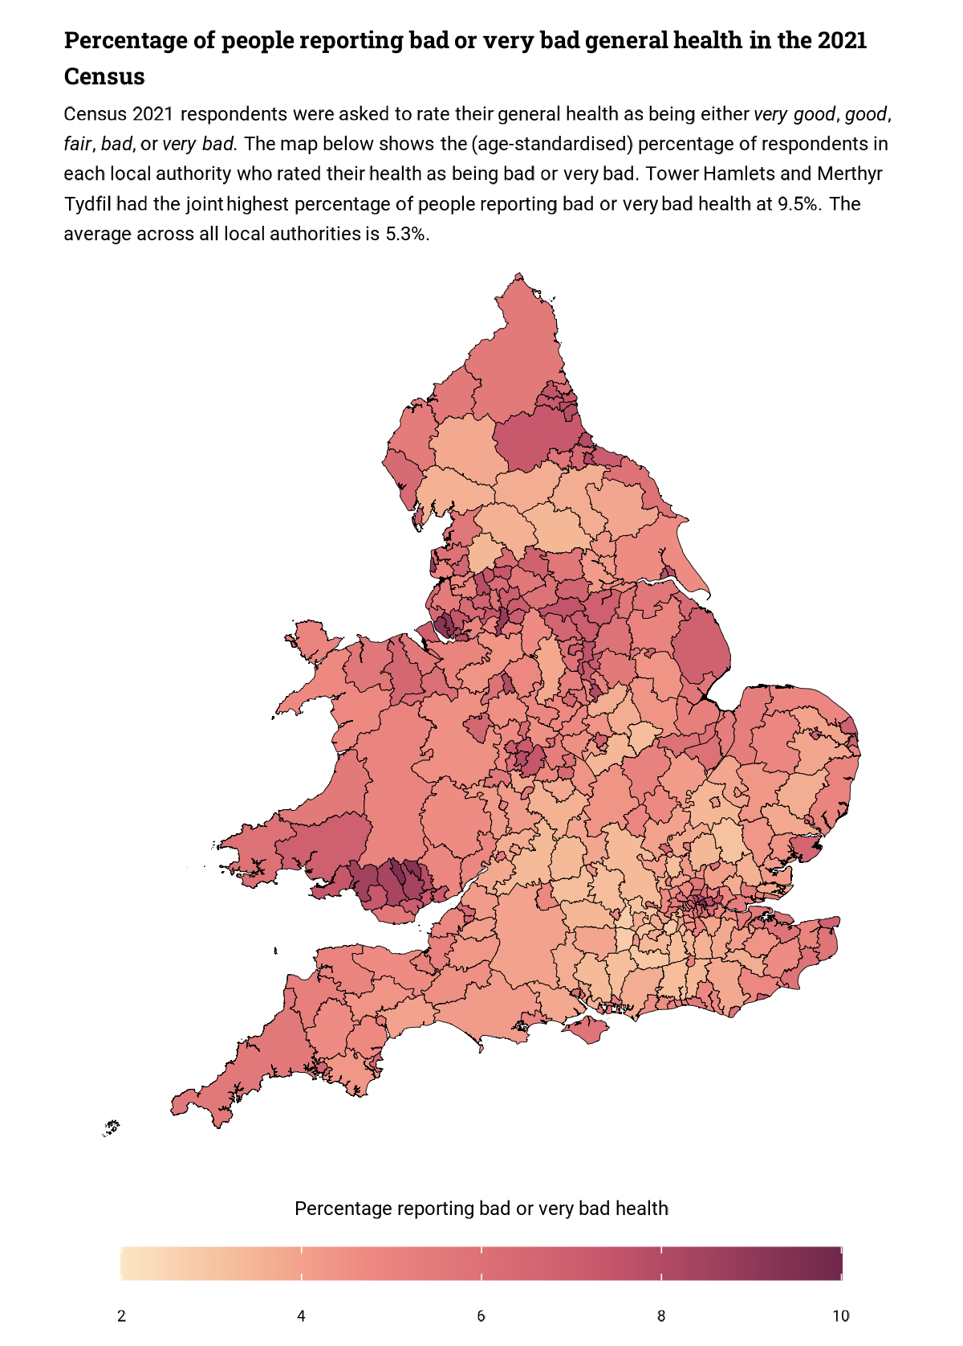
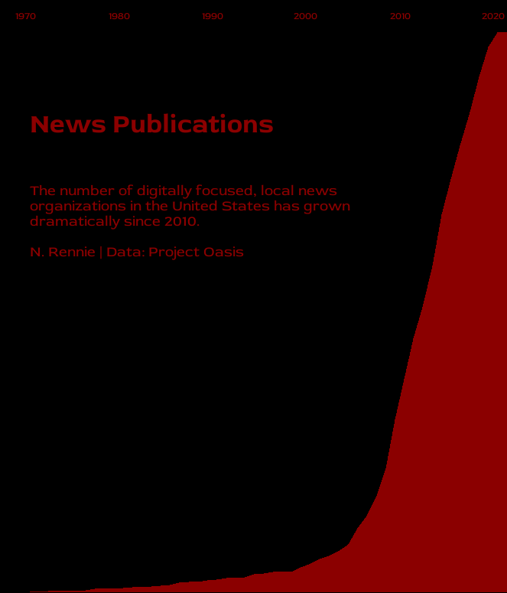
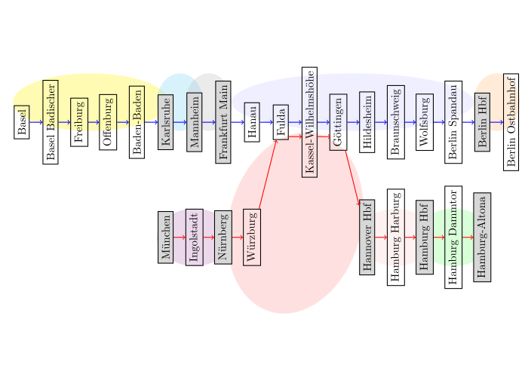
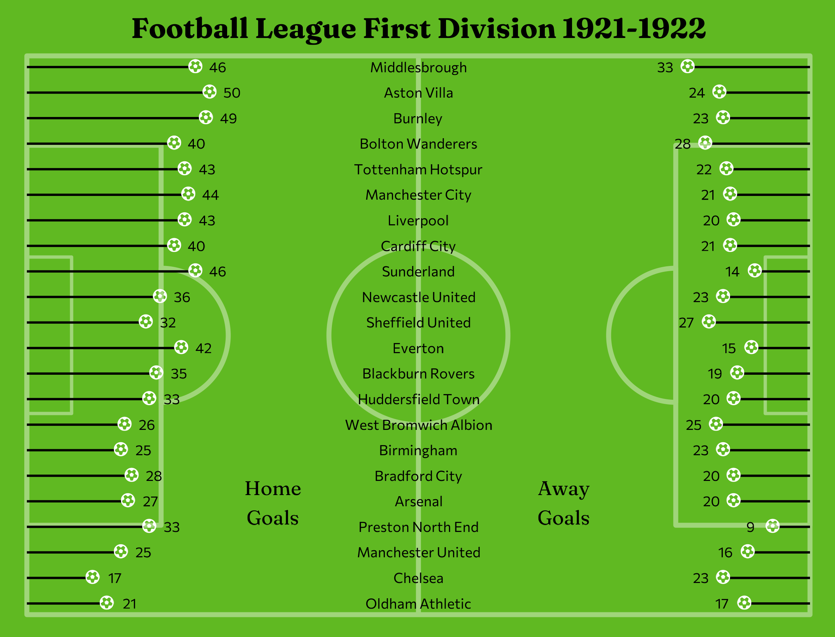
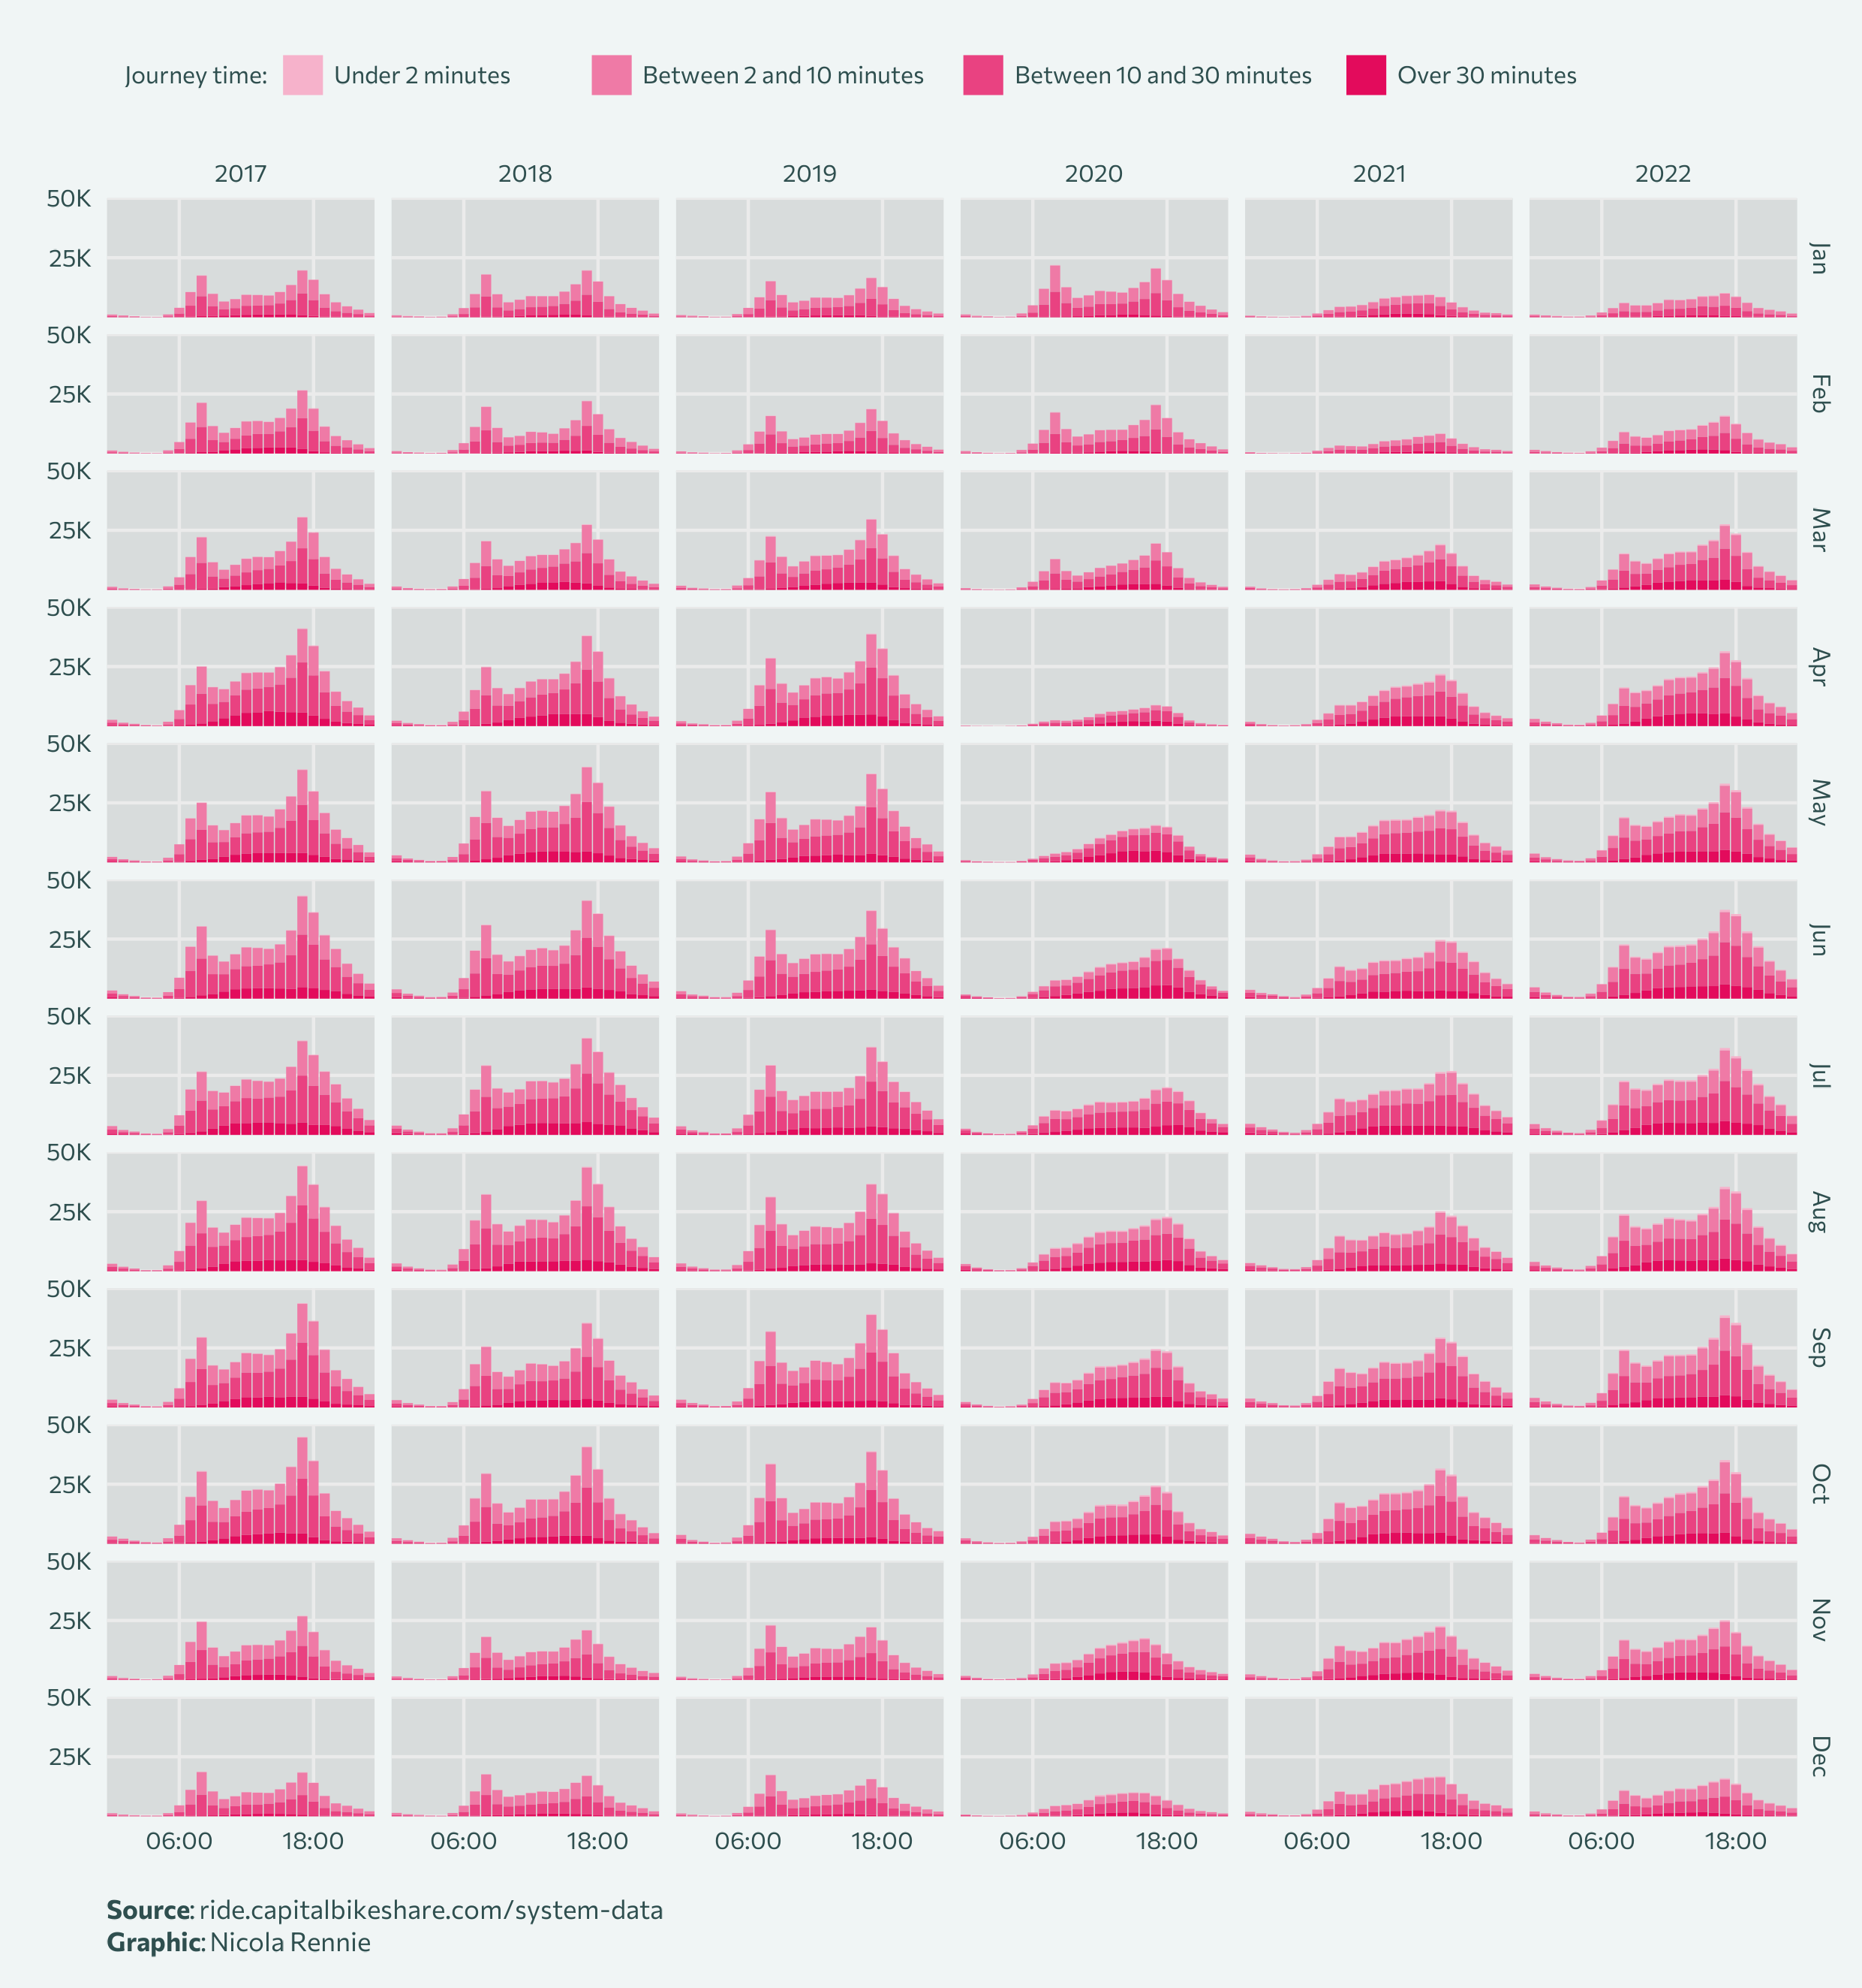
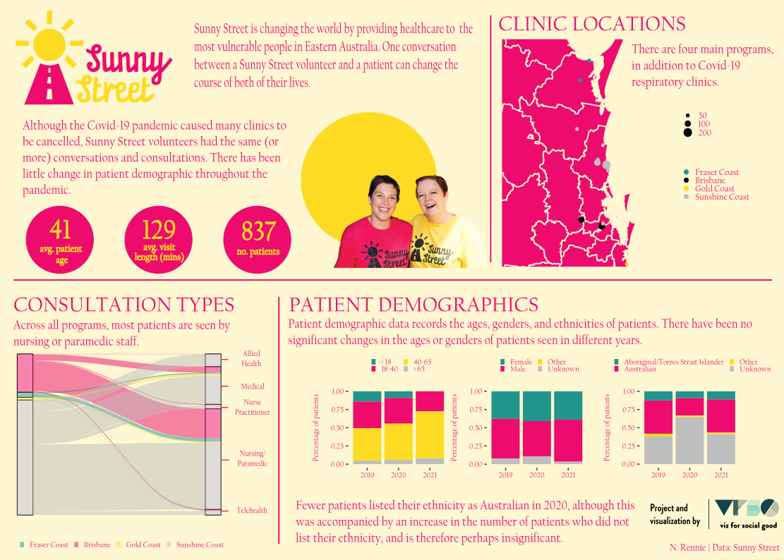
Some of the work
I do
Notes:
Since I got started in statistics, I’ve worked on projects including modelling how many people book tickets for different train journeys, understanding how much fishing is happening in our oceans, investigating changes in life expectancy and retirement age, and exploring how flu spreads in schools.

Slide 4
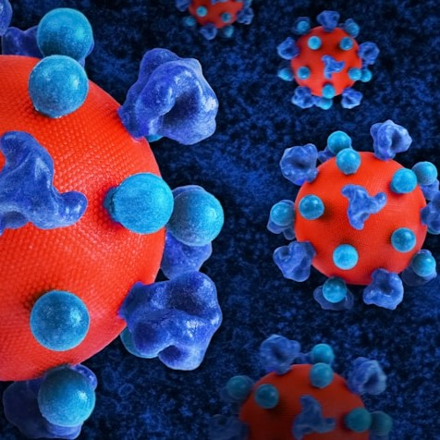

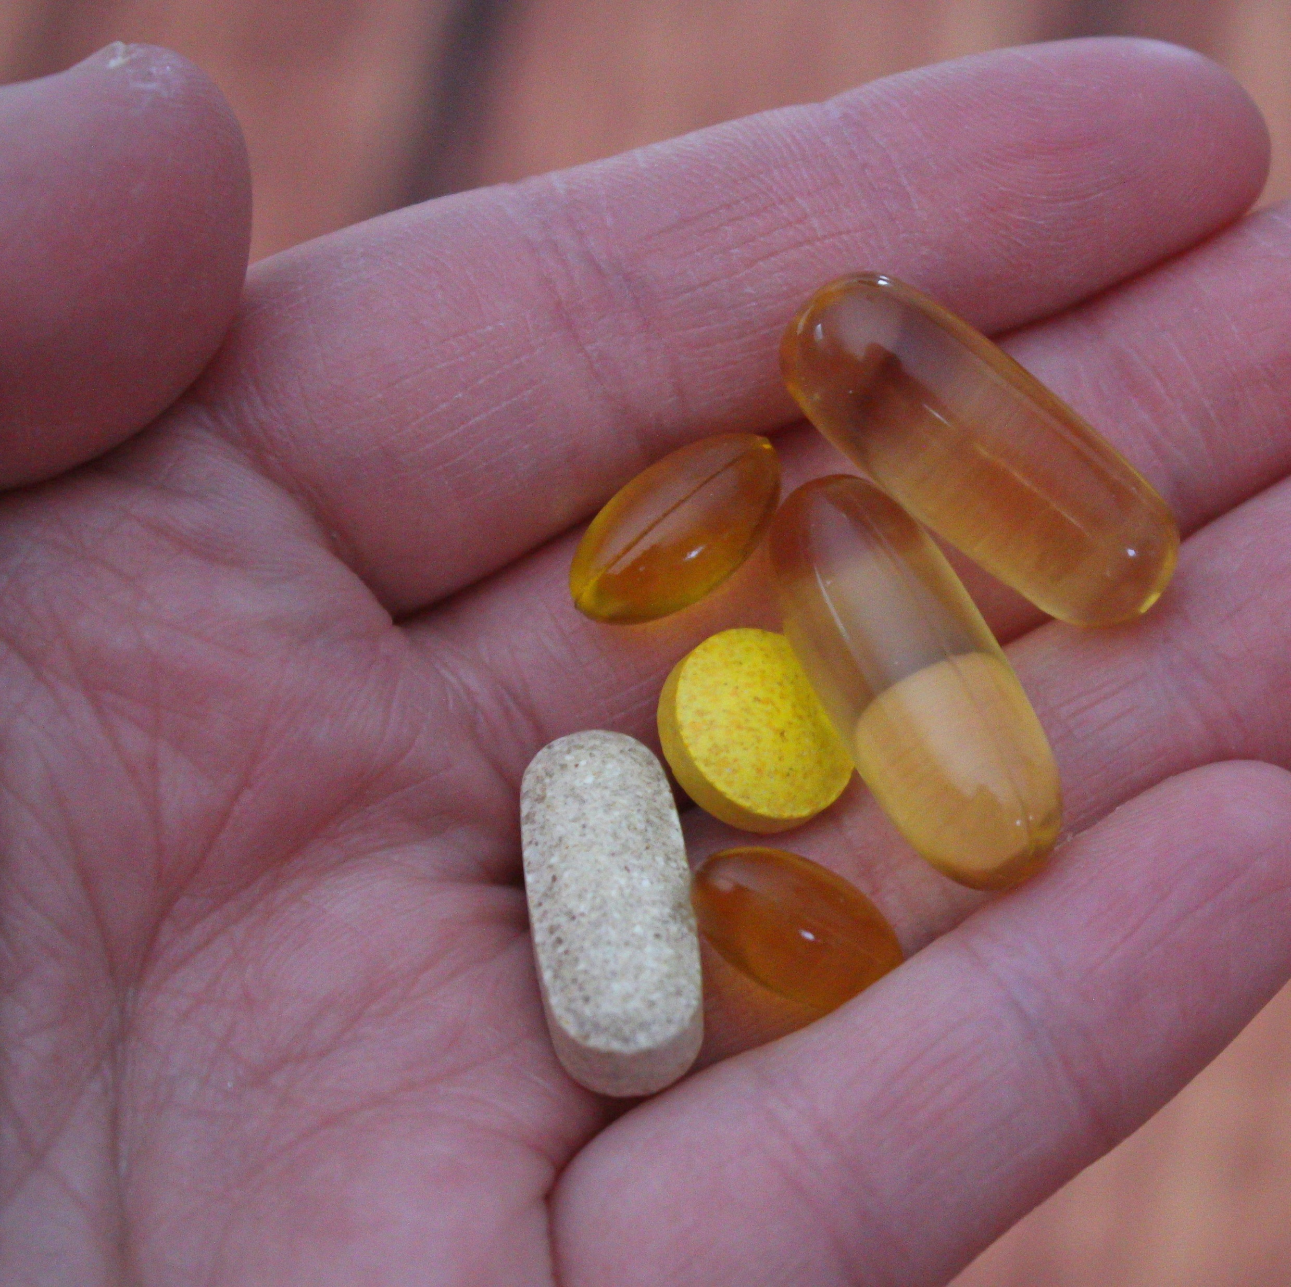
Statistics in medicine
Notes:
What I’m going to talk to you about today, is using statistics in medicine. There are lots of examples of using statistics in medicine - whether that’s to investigate where an infectious disease outbreak started, explore the risk factors for different diseases, or study whether different medical treatments work. When we do a study of new medical treatments and look at their effects on human health, this is called a clinical trial.

Slide 5

One of the first clinical trials happened in 1747.
A disease called scurvy was a huge problem for sailors.
12 patients with scurvy on a ship and gave them each one of 6 possible treatments.
Sailors whose daily diet included citrus fruits recovered, but the others still had symptoms.
Citrus fruits (containing vitamin C) could cure scurvy.
Notes:
One of my favourite examples of a clinical trial goes all the way back to 1747. At that time, a disease called scurvy was a huge problem for sailors. Scurvy is caused by not having enough vitamin C - although in 1747, we didn’t know that. James Lind, a Scottish doctor in the Royal Navy, selected 12 patients with scurvy on a ship, and gave them each one of 6 possible treatments. Some of the treatments included drinking vinegar, eating garlic paste, drinking sea-water, or eating citrus fruits like lemons or oranges. The sailors whose daily diet included citrus fruits recovered, but the others still had symptoms - showing that citrus fruits could cure scurvy.

Slide 6
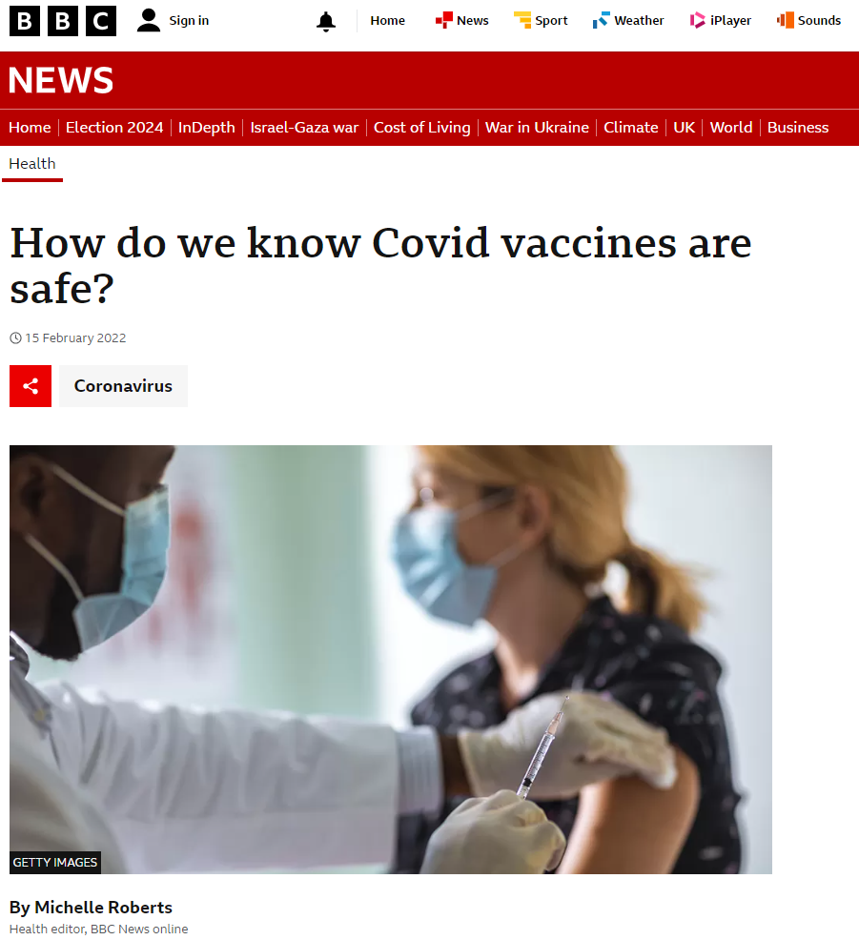
How do we know that a medicine will work?
How do we know how much of that medicine to give patients?
How do we know it is safe to give patients?
What are the side effects of the medicine?
Does it work equally well for all patients?
Notes:
Coming back to the modern day, now clinical trials are used to test the safety and effectiveness of all kinds of medical treatments. So let’s think about a more modern problem. I want you to think about the last time you had a headache, or an earache, or you just weren’t feeling very well. Maybe you told your parents, or a teacher, or another responsible grown up that you weren’t feeling well. And maybe they gave you some medicine, or they took you to a doctor or nurse who gave you some medicine. How did they know that that medicine would work? How did they know how much of that medicine to give you? And how did they know it was safe to give you?
Some of you might have seen or heard discussions about these questions a few years ago when Covid vaccines were first introduced. But it’s not just vaccines we’re talking about. We need to understand these questions for all medicines and treatments.
Maybe the obvious answer to these questions is - the medication has been tested. But that’s quite a simple answer. How can we be quite certain that a medicine is working? How many people should a medicine be tested on? How do we decide which people it should be tested on? That’s where statistics comes in.

Slide 7
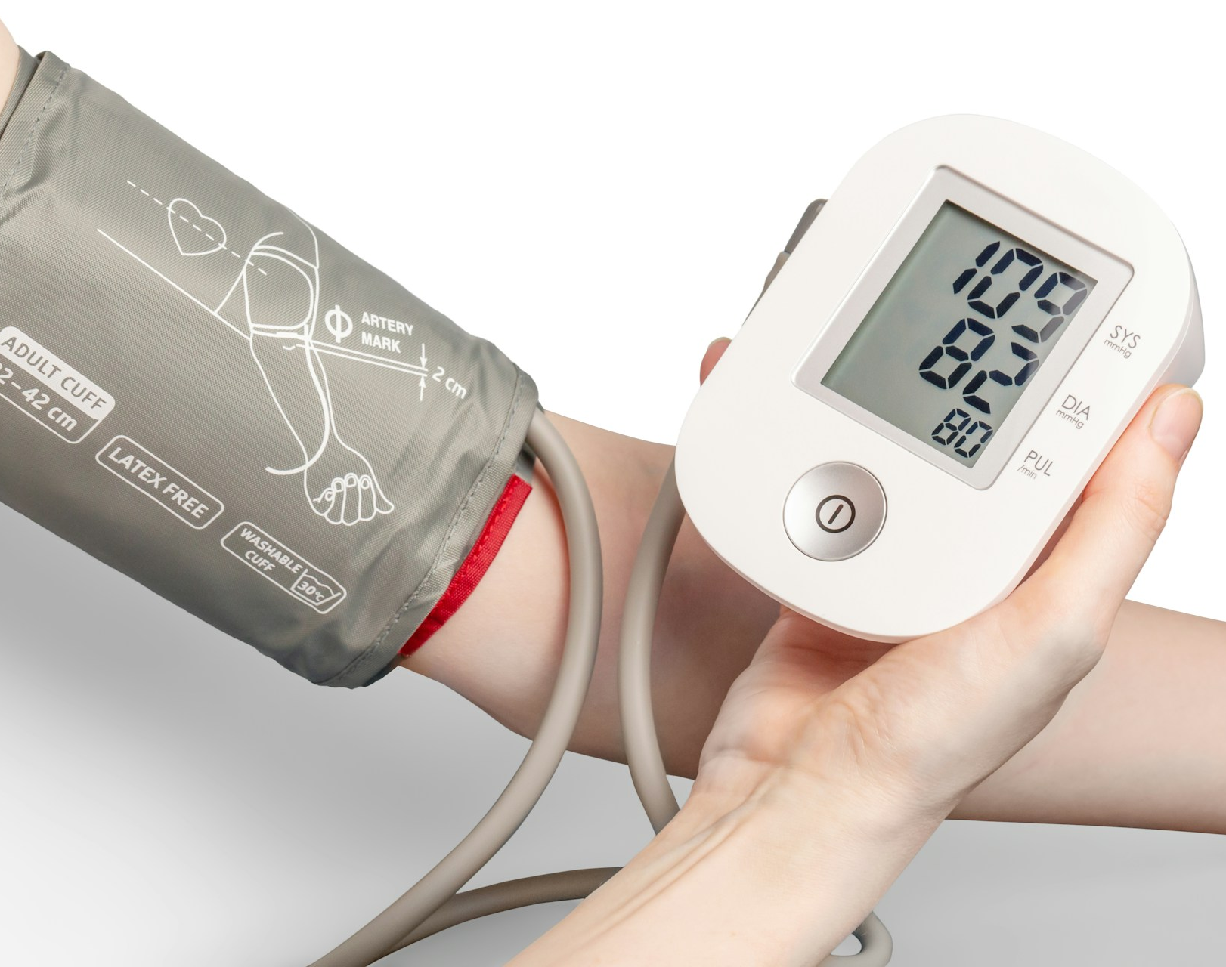
Blood pressure is measured using a blood pressure monitor.
High blood pressure can increase risk of other, more serious, health conditions.
Notes:
Let’s say someone has developed a new treatment for high blood pressure. Blood pressure is the force of your blood pushing against the walls of your blood vessels as your heart pumps the blood around your body.
It can be measured using a blood pressure monitor - it’s usually a cuff that wraps around your arm and gives us two numbers back out - a maximum and a minimum pressure. If these numbers are high, so if they’re above some threshold, then the person would have high blood pressure. High blood pressure can increase your risk of other, more serious, health conditions so it’s important that it gets treated.

Slide 8
How do we know if a treatment works?
Notes:
How do we test if this new high blood pressure treatment works?

Slide 9
What do we measure?
Text goes here
Notes:
Let’s start with the first question - what do we mean by “the treatment works”. We need to start by deciding what we’re going to measure. We could measure someone’s blood pressure after they have taken the new treatment. But that doesn’t really tell us much about the treatment. We don’t know if their blood pressure has actually changed if we only have one number.
Instead, we need to measure the change in blood pressure before and after treatment. We measure someone’s blood pressure, then give them the new treatment maybe for a few weeks, and then measure their blood pressure again. And we could look at the change in the two blood pressure readings. To keep it simple, here we’ll just look at one of the two blood pressure values - the maximum. Often called the systolic blood pressure.

Slide 10
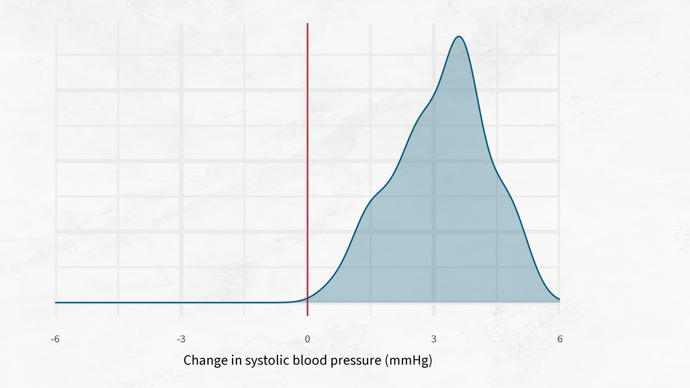
Notes:
For each person we have information about their change in blood pressure before and after treatment, and we know which treatment they received. One of the things we should do, is look at the data and make some plots.
A density plot can be really useful for this type of data. A density plot is a type of graph that shows where data points are bunched up, and where they are spread out. Here’s an easy way to understand it: Imagine a a pile of sand that you pour onto a table. The sand forms a hill. The highest part of the hill shows where most of the sand is, and the sides show where there’s less sand. Now, instead of sand, imagine each grain is a piece of data. Here, each grain of sand is the change in the person’s blood pressure reading. Where the sand hill is highest, that’s where most of the data points are.

Slide 11
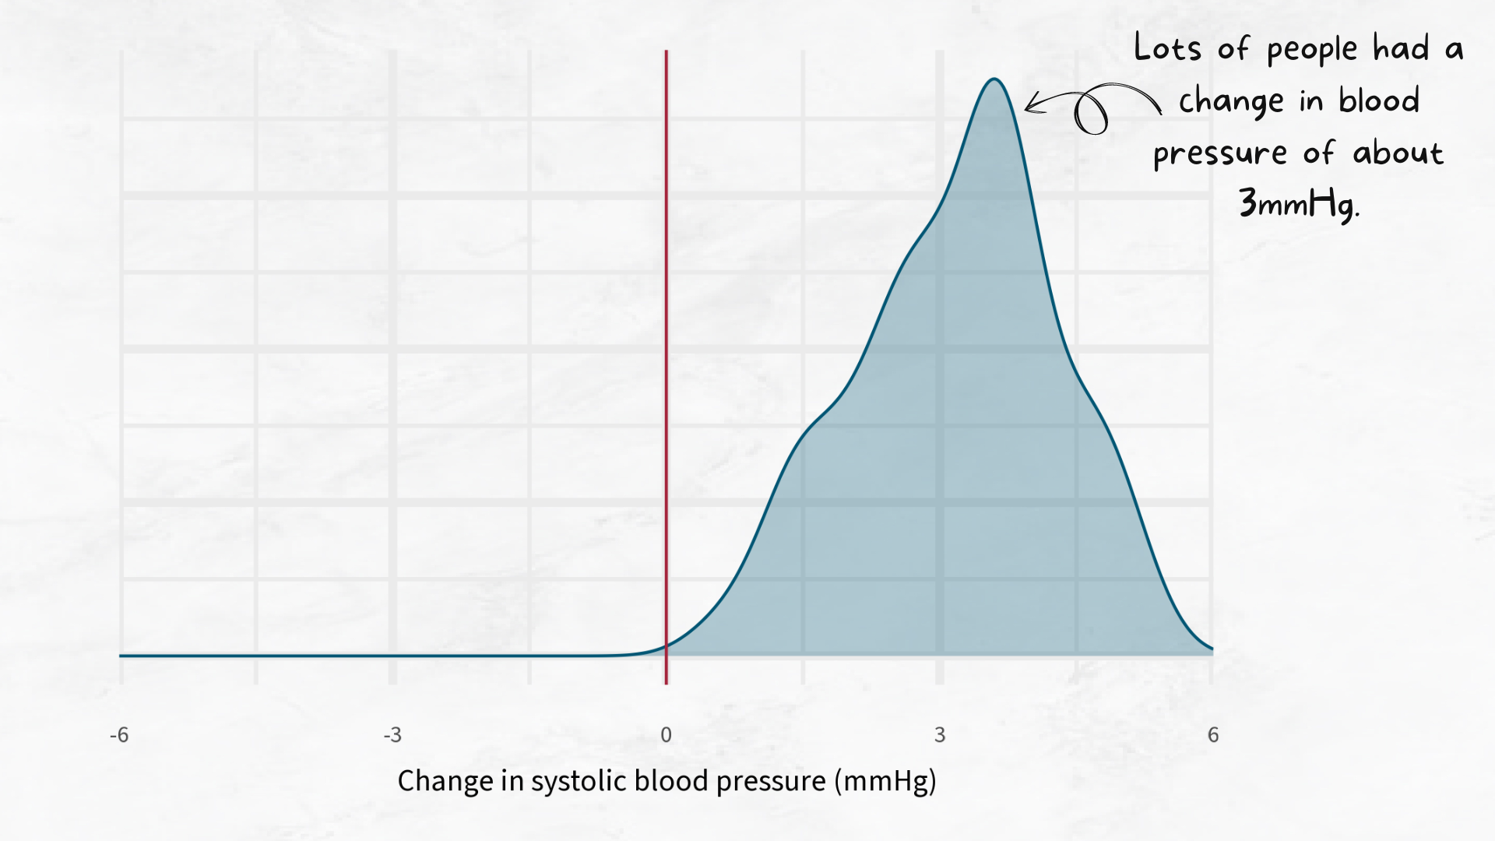
Notes:
So in this example, lots of people had a change in blood pressure of about three.

Slide 12
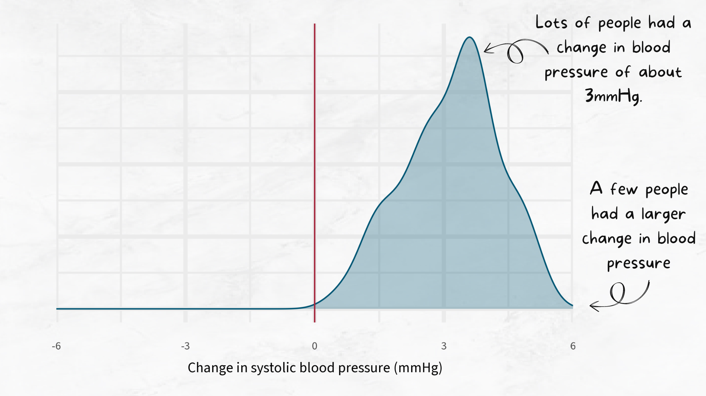
Notes:
A few people had a bigger change.

Slide 13
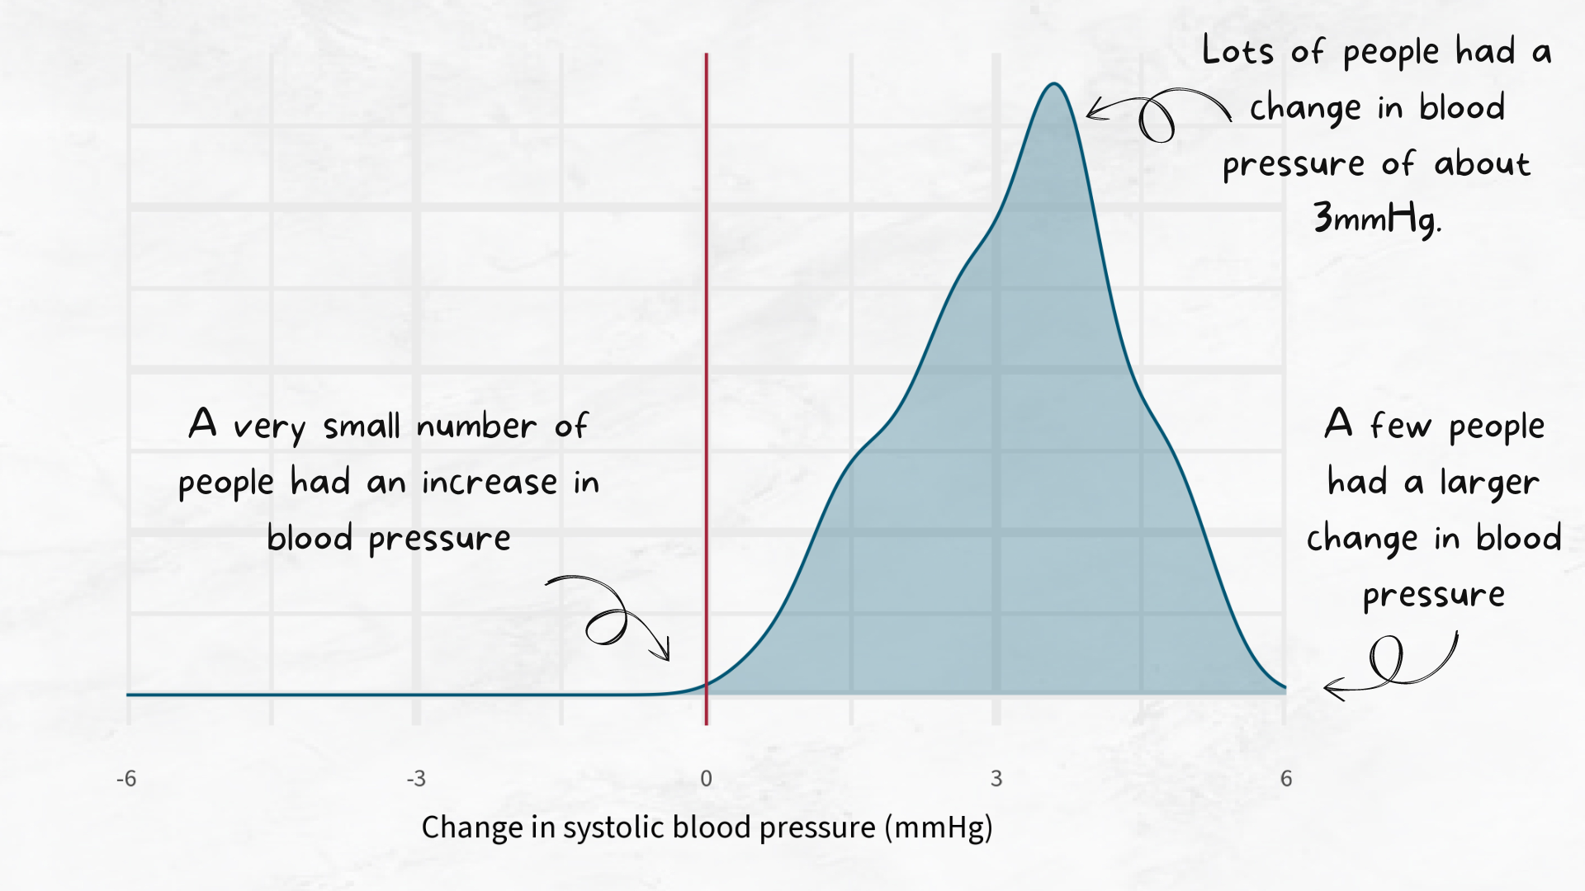
Notes:
And a small number of people actually had an increase.

Slide 14
How many times do we test a medicine?
Notes:
If the blood pressure has come down, does that mean the new treatment is working? Maybe. Blood pressure changes a lot during the day. For example, it’s usually higher when you’re hungry and then reduces after you’ve had lunch. Maybe, the blood pressure reading is only lower because the person just had a sandwich, rather than because of the new treatment. We could ask a patient to do the blood pressure measurements at the same time of day, but we can’t control for every factor in a person’s life.
One way we deal with this, is by testing the treatment on lots of different people. So how many people do we test? 5? 500? 5000? 5 million? 5 probably isn’t enough. We probably need more than 5 if we want to be more certain that any change is due to our new treatment. 5 million is almost certainly enough. It’s probably more than enough. And including 5 million people in our study is very expensive, and very inconvenient for 5 million patients. So we know it’s somewhere between 5 and 5 million. How do you decide on a more specific number?

Slide 15
How many people do we need?
Text goes here
Notes:
First we need to decide how sure you want to be: Imagine you want to be very confident that your results are close to the truth. This is like saying, “I want to be very sure that the results from my sample group are similar to what would happen if everyone took the medicine.”. The more sure we want to be, the more people we need.
We also need to estimate how much people’s reactions might vary. For example, if you think almost everyone will have a similar reduction in blood pressure, there isn’t much variety. But if you think some people’s blood pressure might drop a lot, and some people’s only a little bit, there’s a lot of variety. The more variety there is, the more people we need.
We also need to think about how big a change in blood pressure, we expect. If we think the change in blood pressure will be very big, then it will be easier to spot. If we think the change in blood pressure will be quite small, it’s harder to check if the change is real or just variability. The smaller the change we’re trying to find, the more people we need.
Once we know these piece of information, statistics helps us to calculate the minimum number of people the should be included in the clinical trial.

Slide 16
How do we decide who gets which treatment?
Notes:
If the blood pressure has come down, does that mean the new treatment is working? Maybe. Blood pressure changes a lot during the day. For example, it’s usually higher when you’re hungry and then reduces after you’ve had lunch. Maybe, the blood pressure reading is only lower because the person just had a sandwich, rather than because of the new treatment. We could ask a patient to do the blood pressure measurements at the same time of day, but we can’t control for every factor in a person’s life.
One way we deal with this, is by testing the treatment on lots of different people. So how many people do we test? 5? 500? 5000? 5 million? 5 probably isn’t enough. We probably need more than 5 if we want to be more certain that any change is due to our new treatment. 5 million is almost certainly enough. It’s probably more than enough. And including 5 million people in our study is very expensive, and very inconvenient for 5 million patients. So we know it’s somewhere between 5 and 5 million. How do you decide on a more specific number?

Slide 17
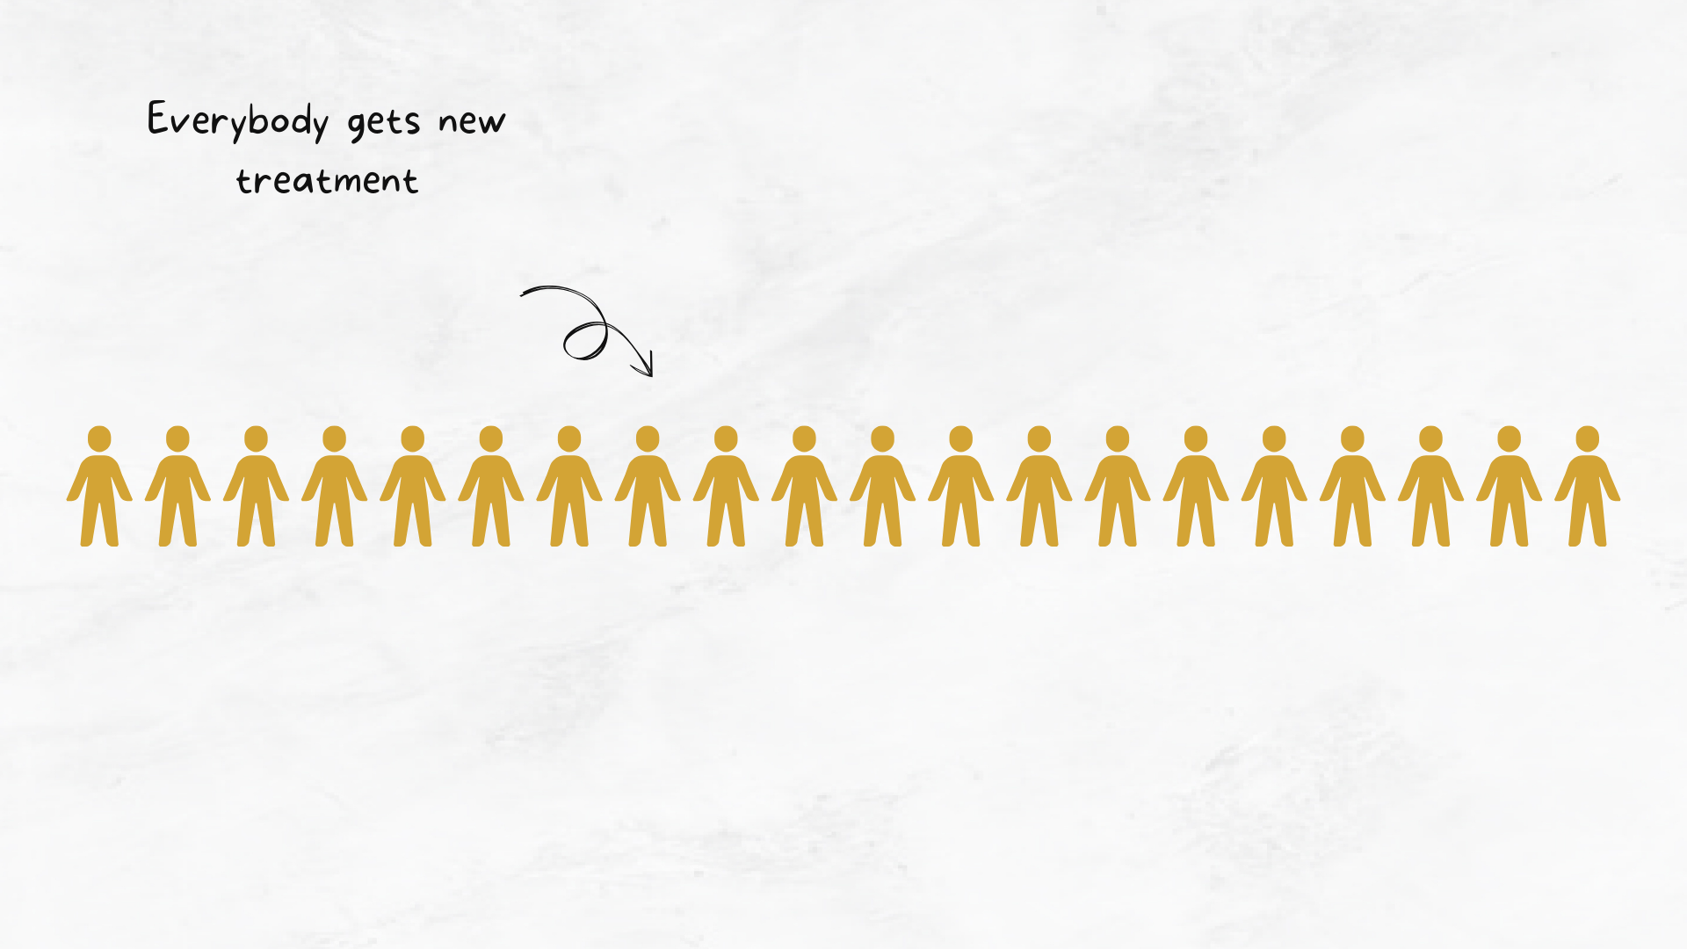
Notes:
So we know how to decide how many people we need to include in our study. Often, we don’t just want to know if a treatment works. We want to know if it works better than something else. So we need something to compare our new treatment to. Maybe all of these people would have decreased their blood pressure anyway. Maybe the test was done in summer and they all started doing more exercise.

Slide 18
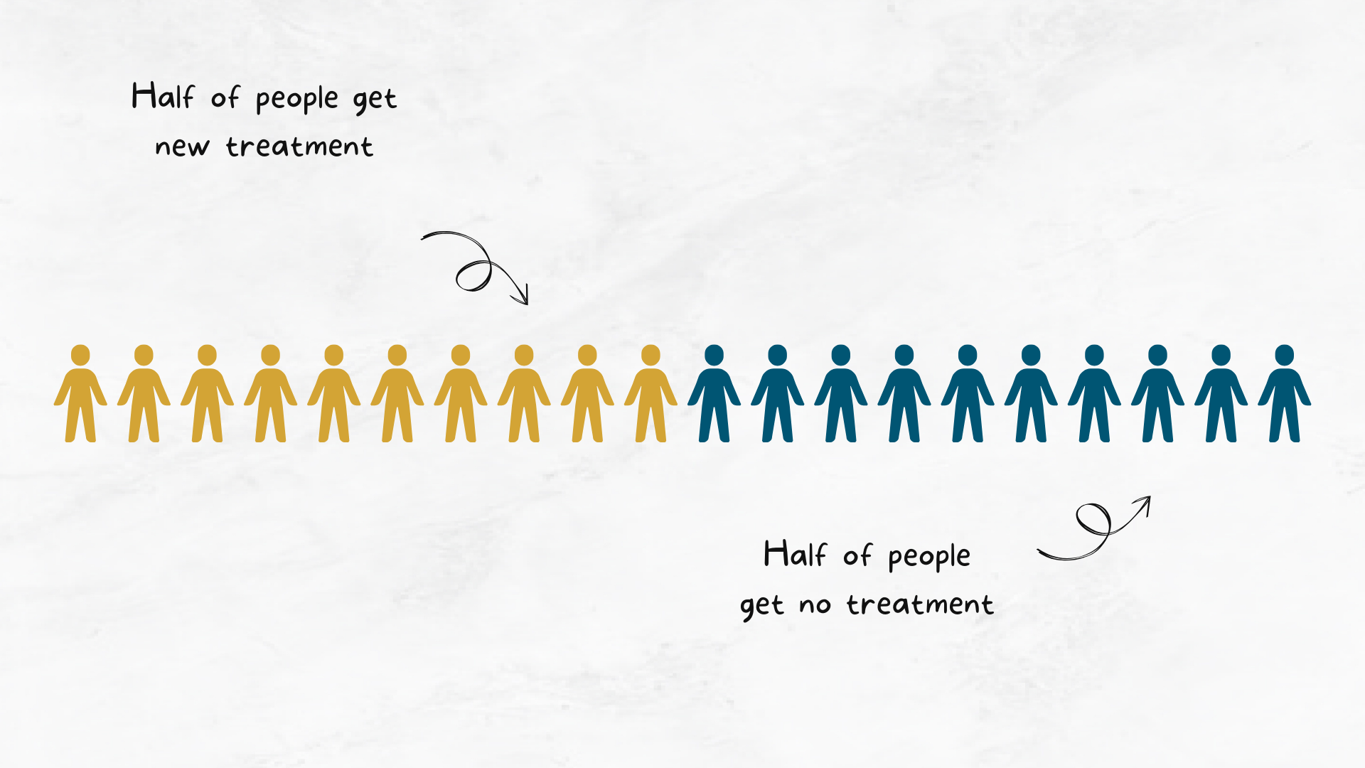
Notes:
There are a few different options for what we compare our new treatment to. We could compare our it to no treatment. Does this new treatment improve blood pressure more than not taking any medication? In medicine, that’s not always a good comparison. Because that means that some people would receive no treatment for their high blood pressure, and that’s not good.

Slide 19

Notes:
So we often compare it to the current treatment for high blood pressure. If we’re comparing a new treatment to an existing treatment, how do we decide who gets which one?
Often, if we have two treatments to compare, we want half to get the new treatment, and half to get the current treatment. To make sure that the study is as fair as possible, we want to randomly decide which of the two treatments each person gets - like flipping a coin. Heads, new treatment. Tails, current treatment.
We do this to make reduce the chances that something other than the treatment is responsible for any changes. For example, imagine we gave the first 10 people the current treatment, and the next 10 people the new treatment. What if people who are more sick go to the doctor first, and so get the current treatment? It might look like the new treatment doesn’t work as well, but it’s actually only because they weren’t as ill to start with.

Slide 20
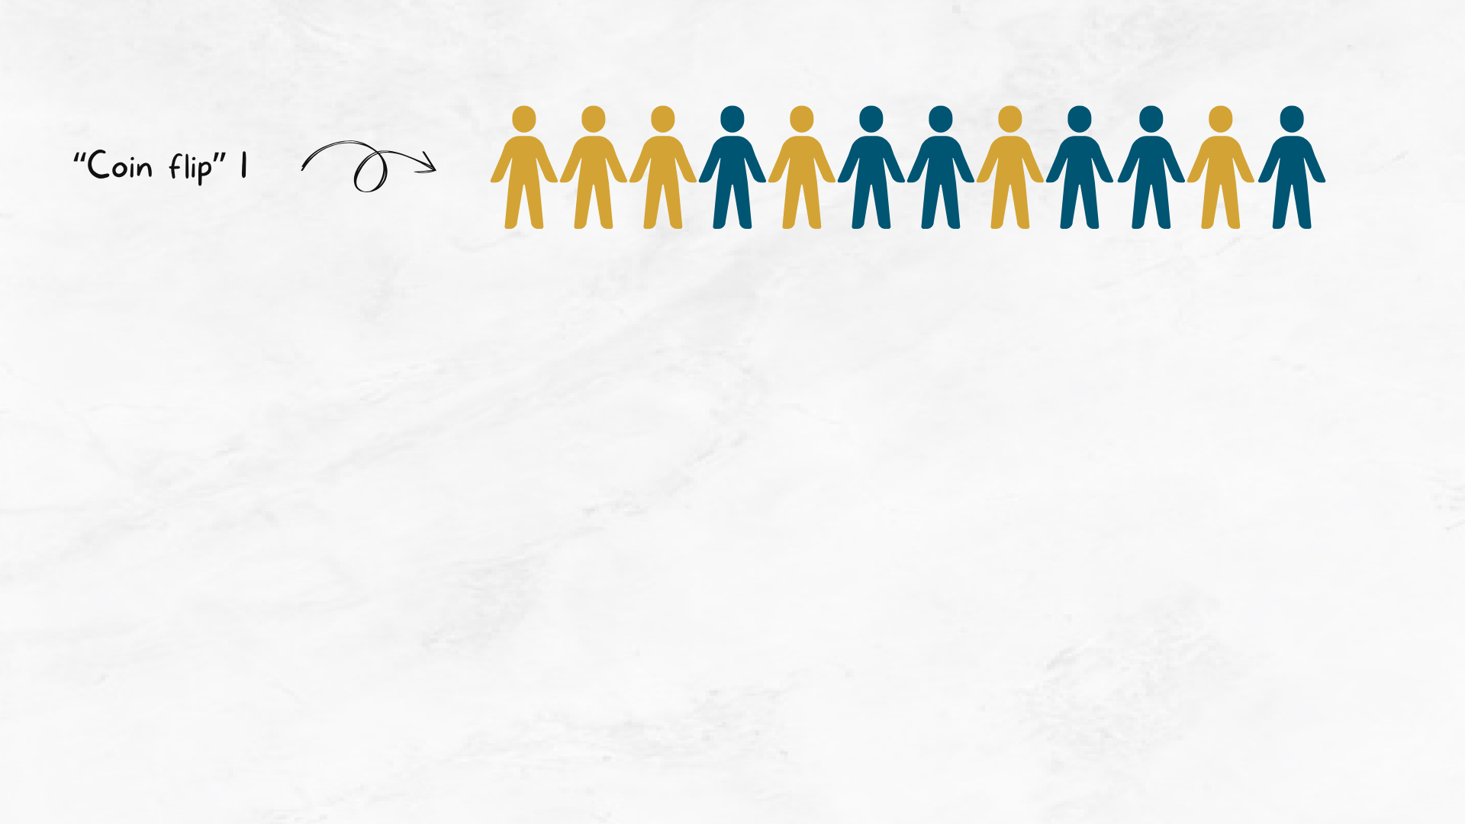
Notes:
Sometimes this “coin-flipping” approach means we don’t get exactly half and half for each treatment. Try flipping a coin 10 times - do you get exactly 5 heads? This isn’t as much of a problem when we have lots of people in a study. If we only have a small number of people in the the trial, we can use more complicated statistical methods to make sure we get equal group sizes.

Slide 21
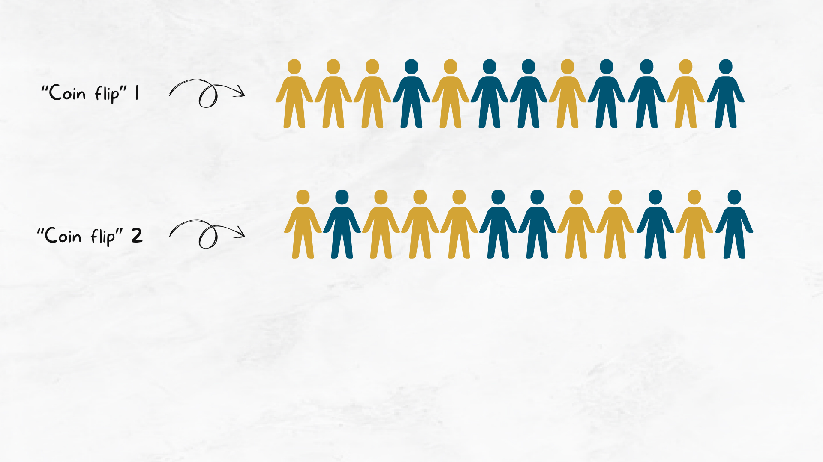

Slide 22
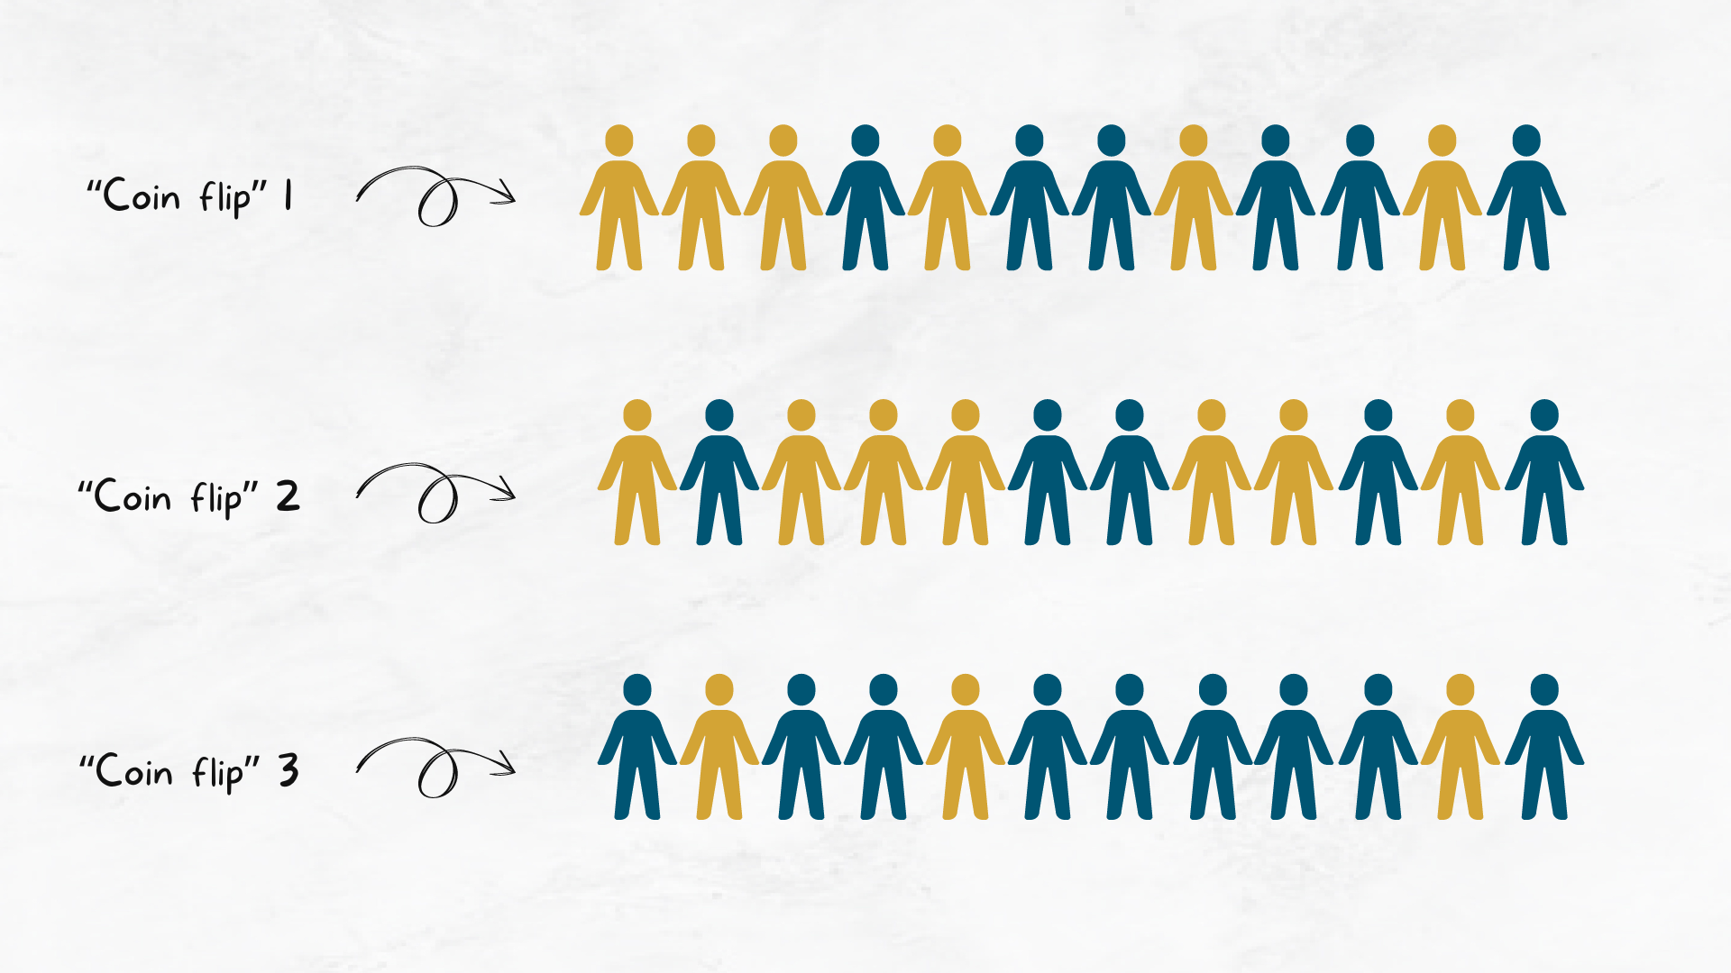

Slide 23
How do we compare two treatments?

Slide 24
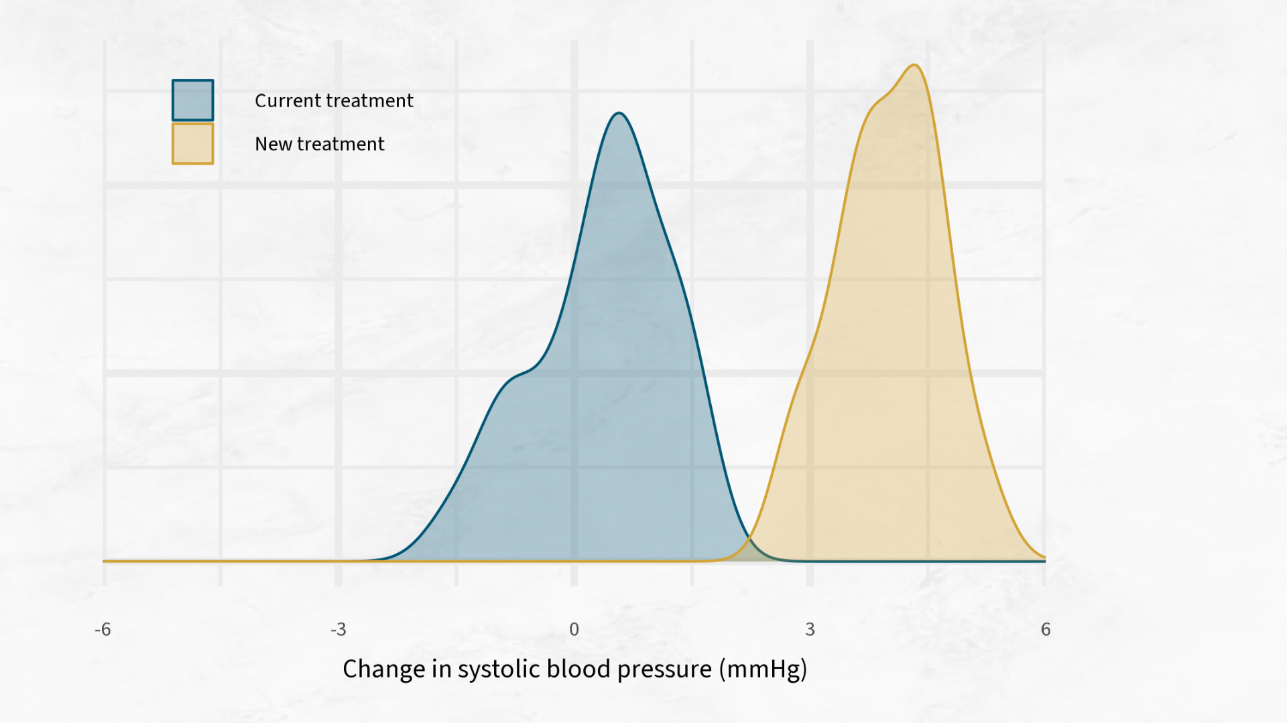
Notes:
We can compare the density plots for each type of treatment. The blue plot shows the changes in blood pressure for people who had the current treatment, and the yellow plot shows the treatment who had our new treatment.

Slide 25
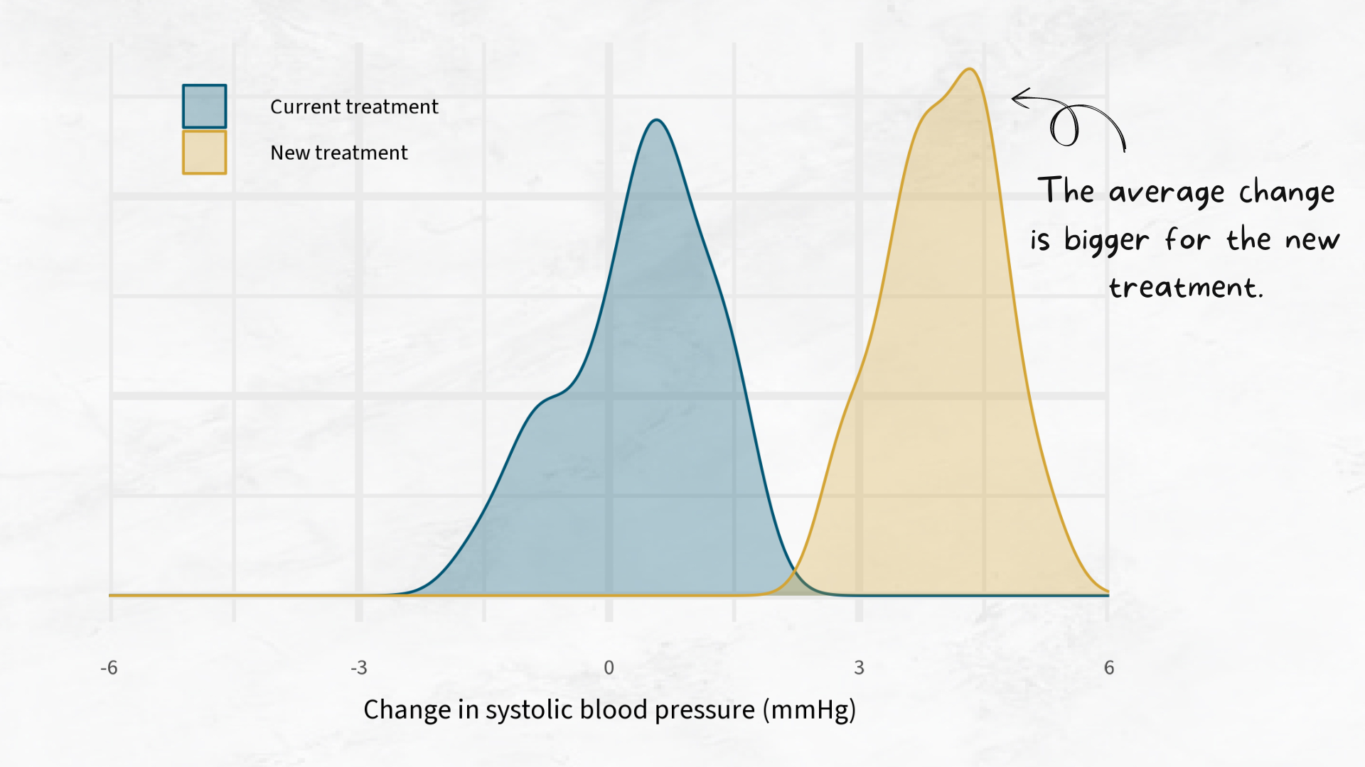
Notes:
You can see that with the new treatment gives a higher drop in blood pressure compare to the current treatment.

Slide 26
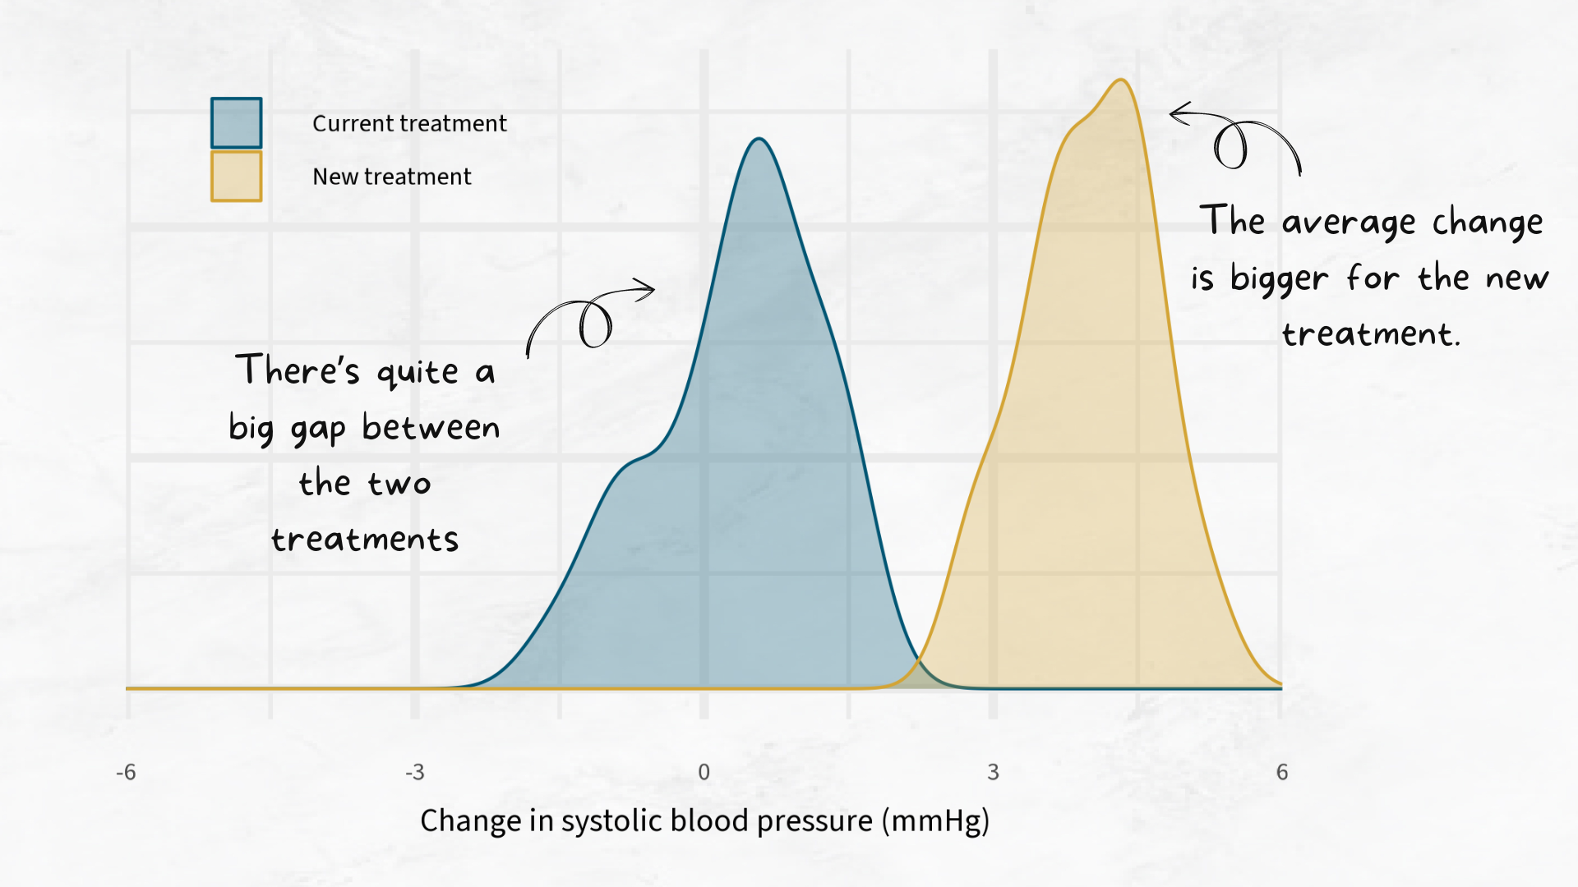
Notes:
There’s a small overlap between the two, but generally it looks like the two treatments are quite different to each other.

Slide 27
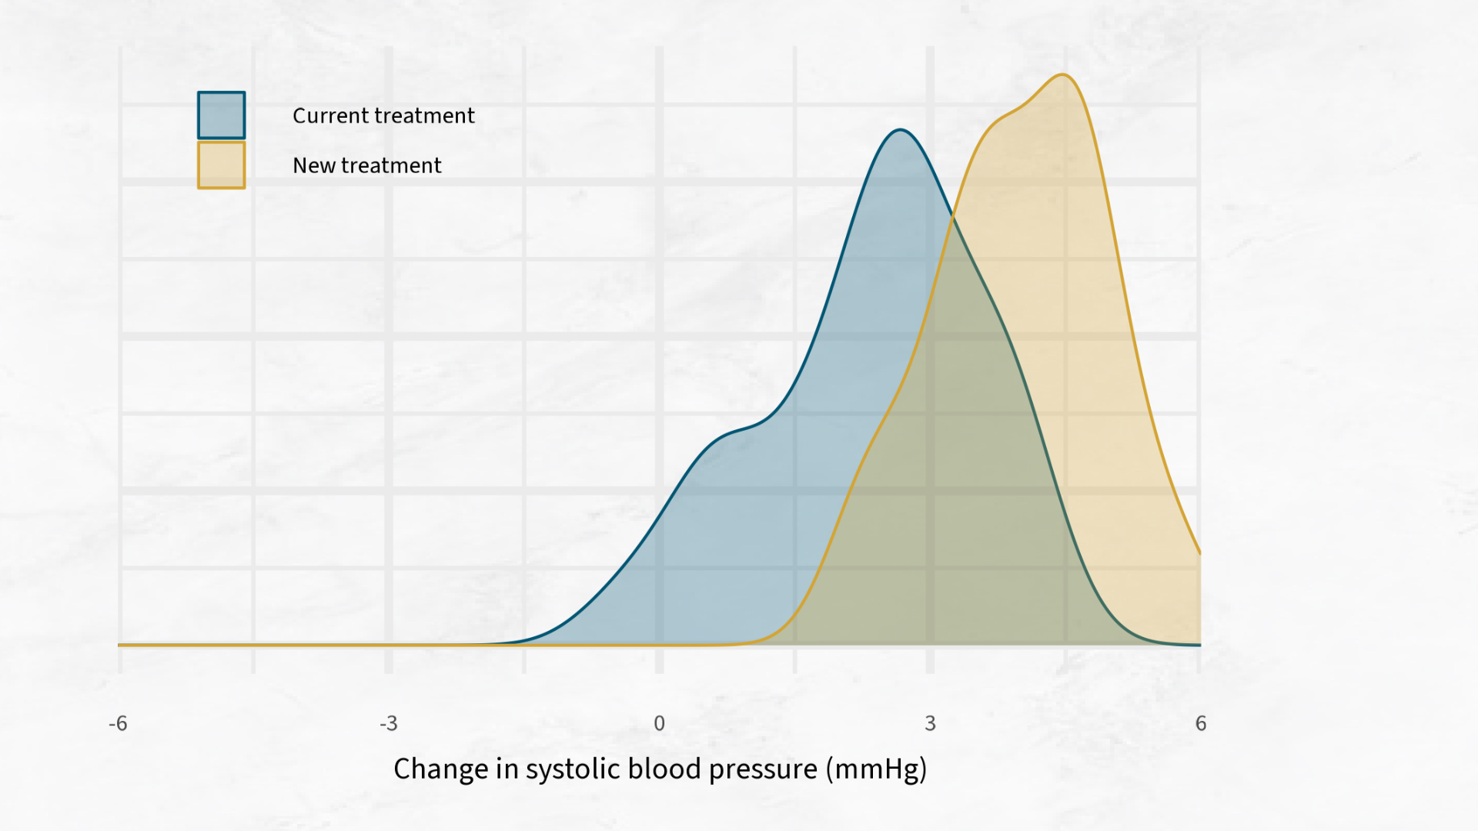
Notes:
It gets a little bit harder to say whether the treatments are actually different from each other when there’s more of an overlap.

Slide 28
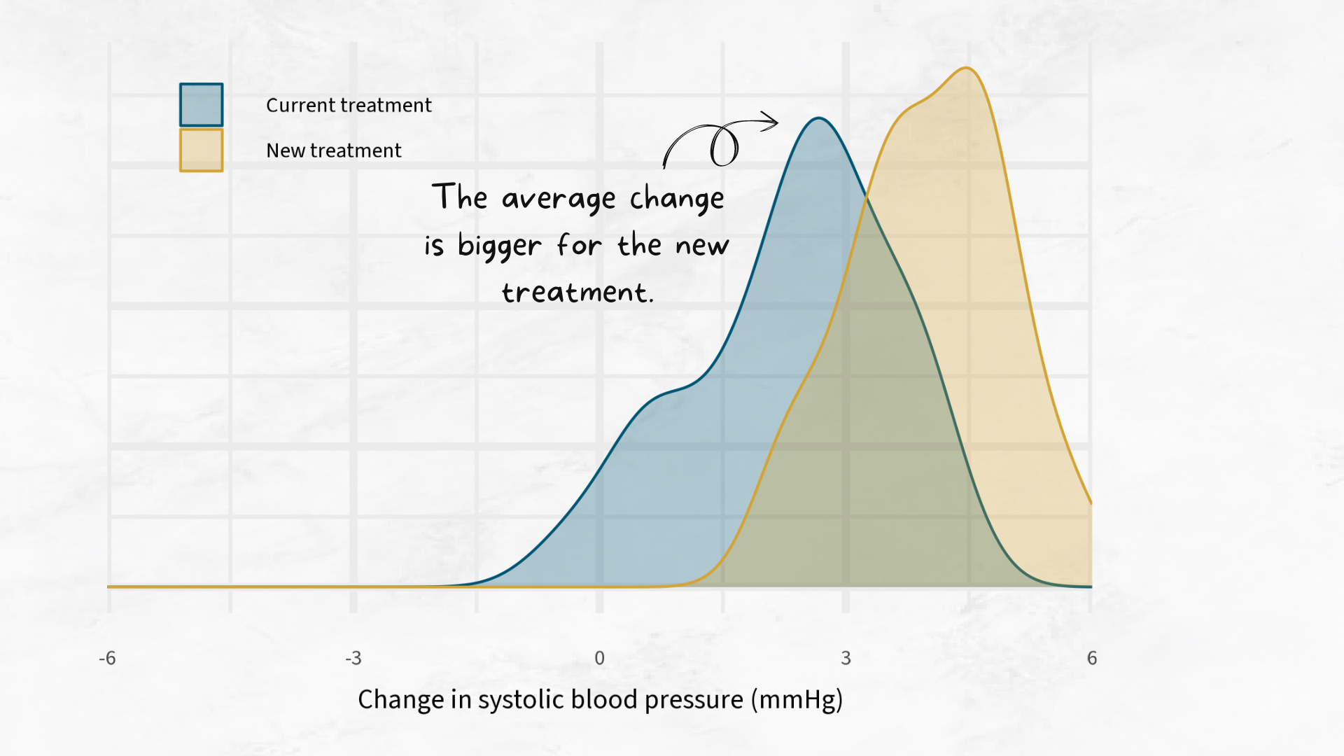
Notes:
Here, the new treatment is still a little bit higher

Slide 29
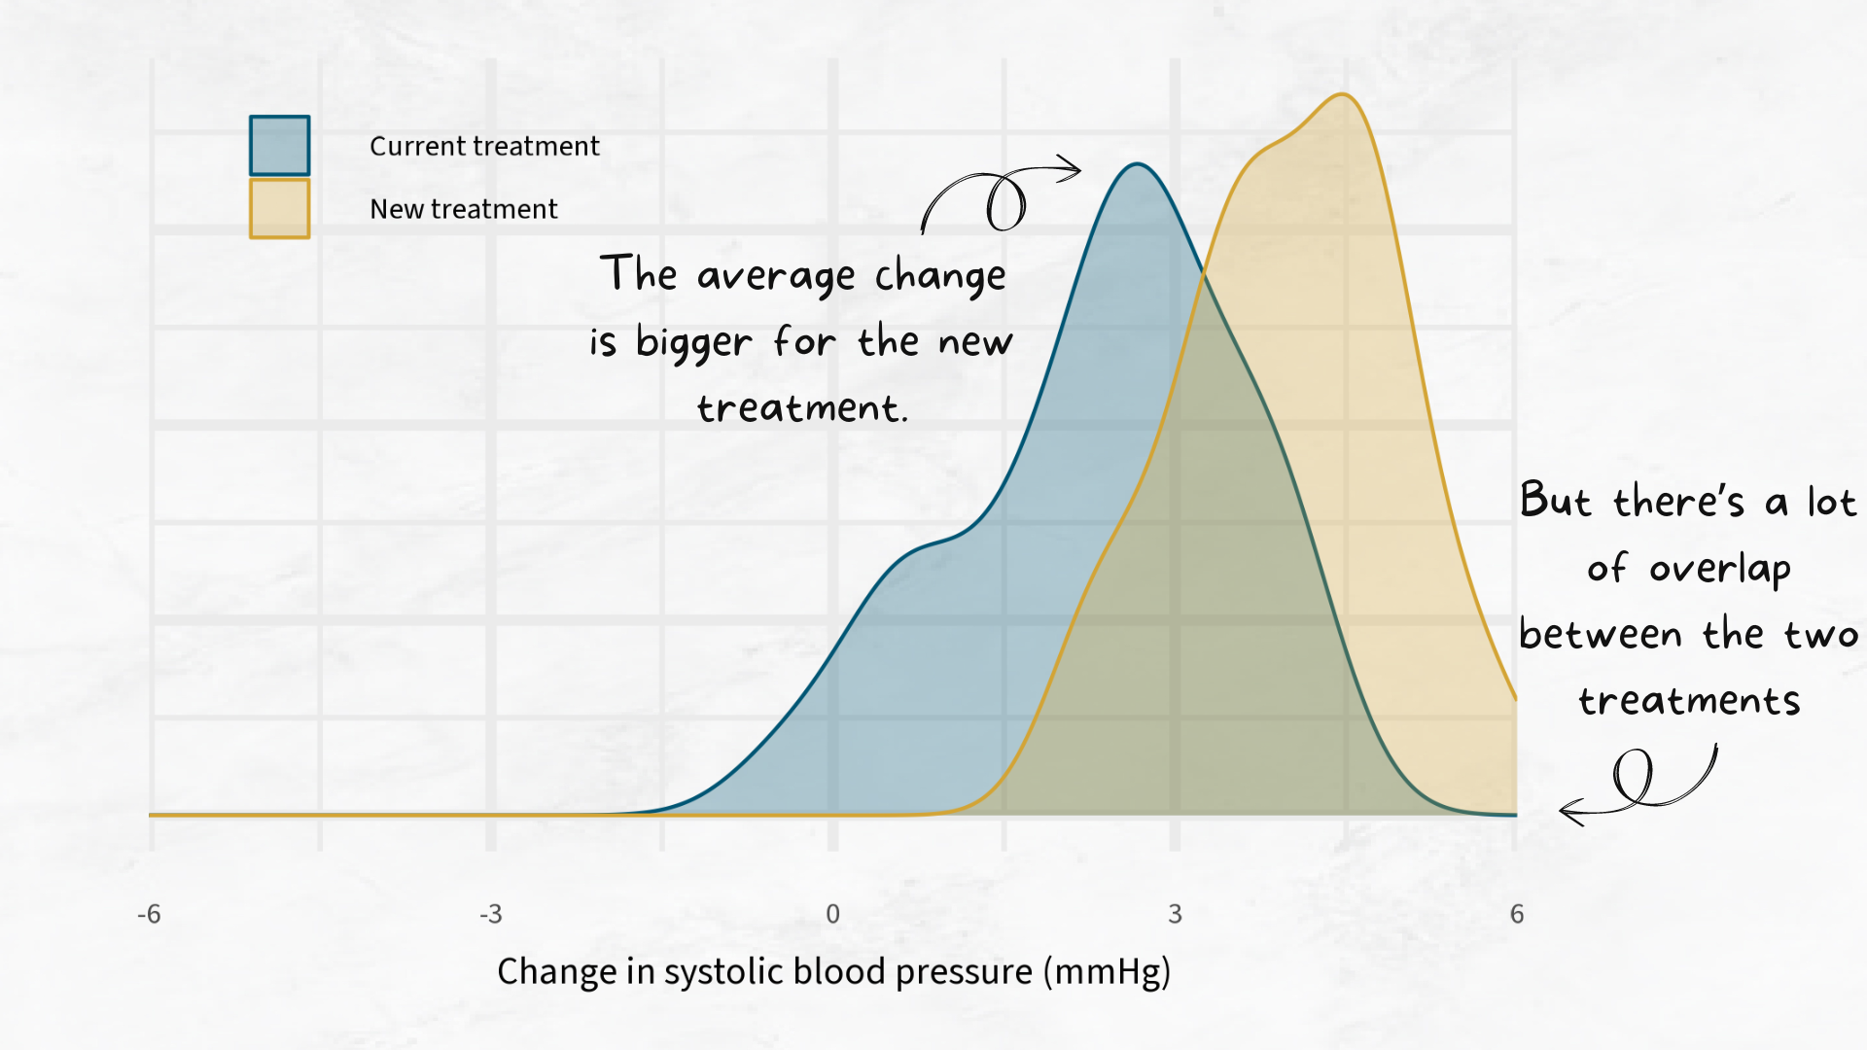
Notes:
but there’s a lot of overlap between the two plots. We can use statistical tests to tell us if it’s likely that the difference between the two treatments is actually real.
Of course, it’s not just about whether treatments are different according to statistics. We need to think about whether they are different enough to make a difference in medical treatment. A new treatment might be better at reducing blood pressure, but if it only reduces blood pressure by 0.5 then it might not be enough to decide to invest lots of money in developing the new treatment. Statistics is a very important part of medical research, but it works best when statistics experts work closely with other people involved in medicine, such as doctors, nurses, biomedical scientists, or technicians.

Slide 30
Summary
Text goes here
Notes:
I hope you’ve been able to see that statistics can lead to a wide variety of jobs, and that having a career within healthcare and medicine doesn’t always mean being a doctor or a nurse. Before I finish, I just want to say thank you very much for listening to me today, and please do ask any questions if you have them.

Slide 31
Questions?
Nicola Rennie
Royal Statistical Society William Guy Lecturer 2024 - 2025

